Slide 1
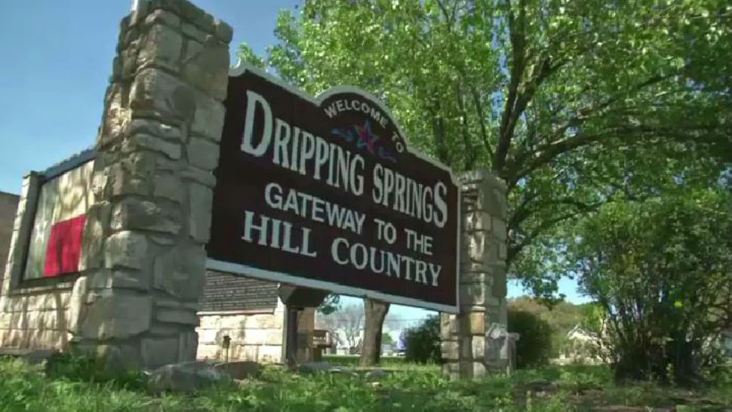
In Search of the “Hill Country”: Using the Foursquare API to Delineate a Vernacular Region in Texas
William Flynn, Ph.D.
March 17, 2020

Slide 2
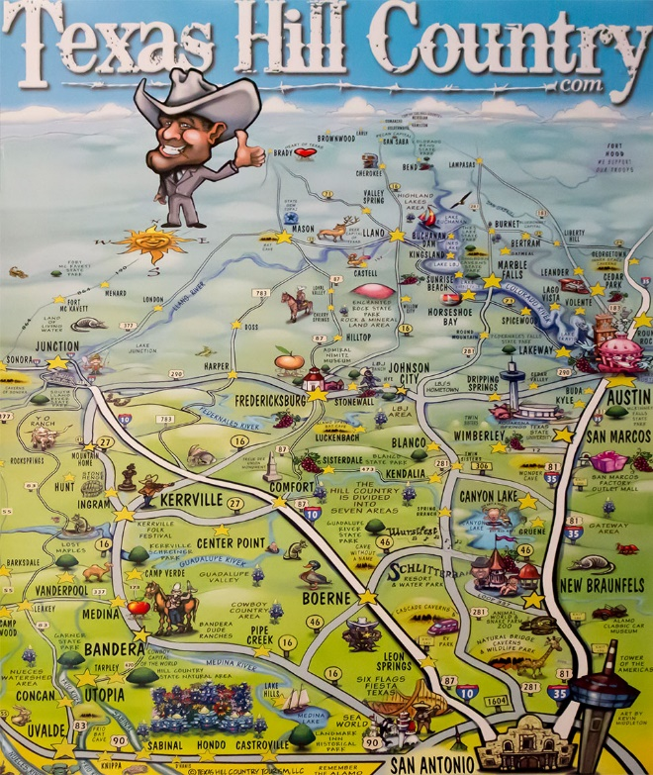
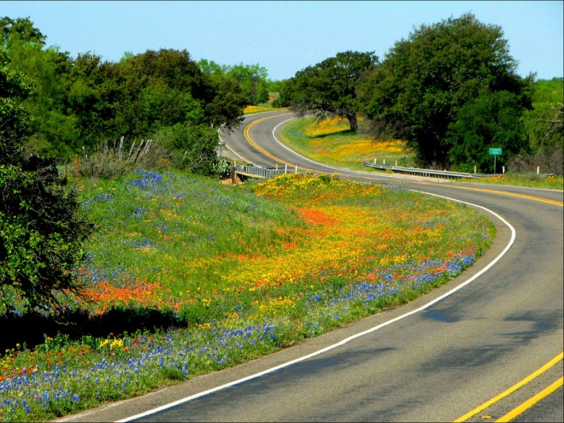
Introduction to the Texas Hill Country
Portions of Central and South Texas
Situated on Edwards Plateau to the west of the Balcones Escarpment that runs along cities of Austin and San Antonio
Favorite spot for scenic drives, leisure, outdoor recreation, landing destination for retirees and snowbirds

Slide 3
Types of Geographic Regions
Formal Region
People share one or more measurable traits, such as a common language, system of beliefs, nationality, or even physical characteristics
Examples: Peru, Sahara Desert, Francophone region of Canada
Functional Region
Set up around a system of interactions
Examples: Public transit network or delivery area of pizzeria
Vernacular / Perceptual Region
Defined by people’s attitudes, feelings, and perspectives about an area; Reflect a “sense of place”
Examples: Dixie, Big Sky, Cascadia

Slide 4
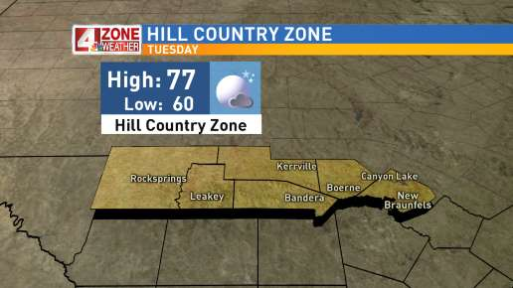
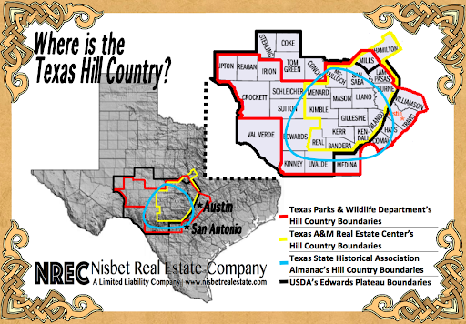
Where is the Texas Hill Country?

Slide 5
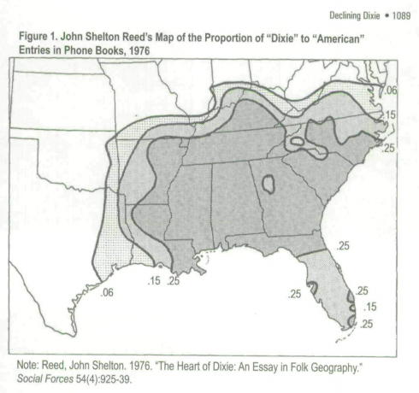
An Old School Approach to Vernacular Geography Study

Slide 6
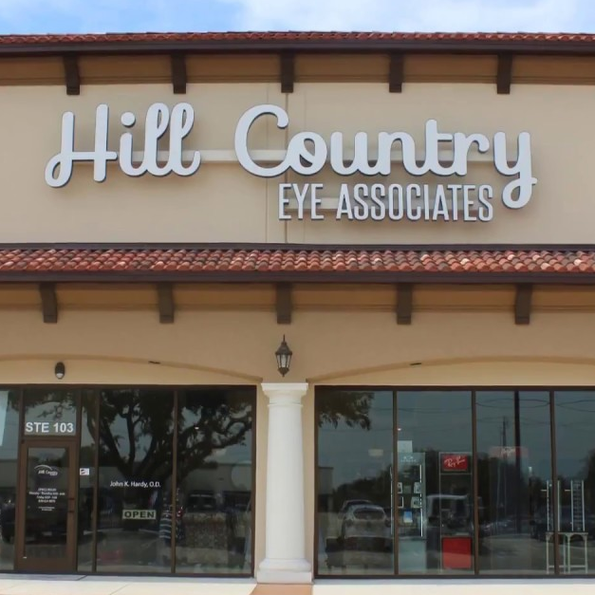
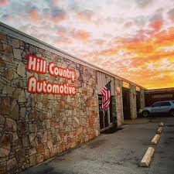

Examples of Hill Country Venues
Hill Country Eye Associates
New Braunfels, TX
Hill Country Automotive
Boerne, TX
Hill Country High School
Kerrville, TX

Slide 7
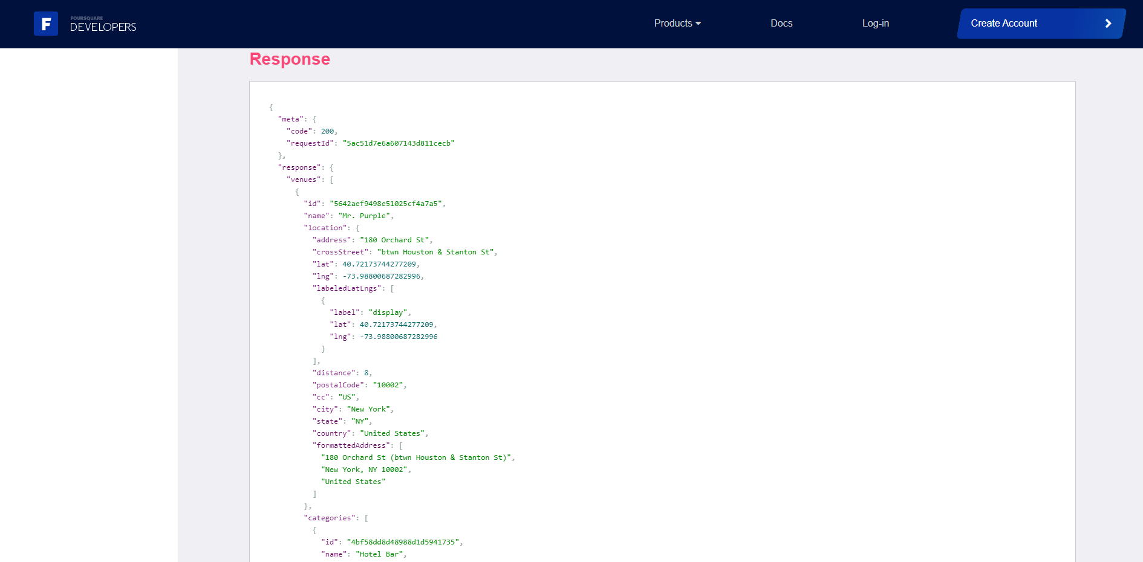
Foursquare Places API

Slide 8
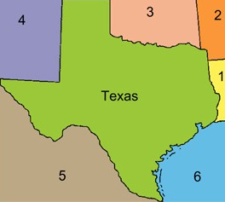
Bounding Box for Texas
Max Latitude: 36.500704° N
Min Longitude: 106.645646° W
Max Longitude: 93.508292° W
Min Latitude: 25.837377° N

Slide 9
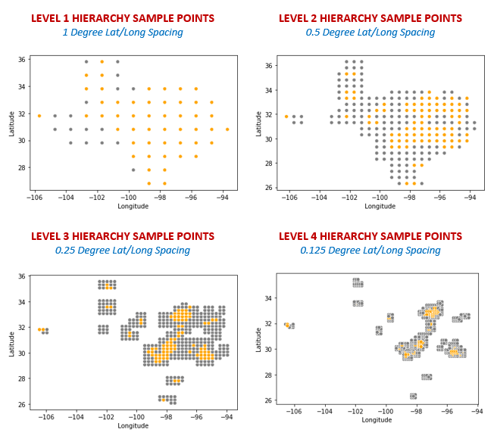
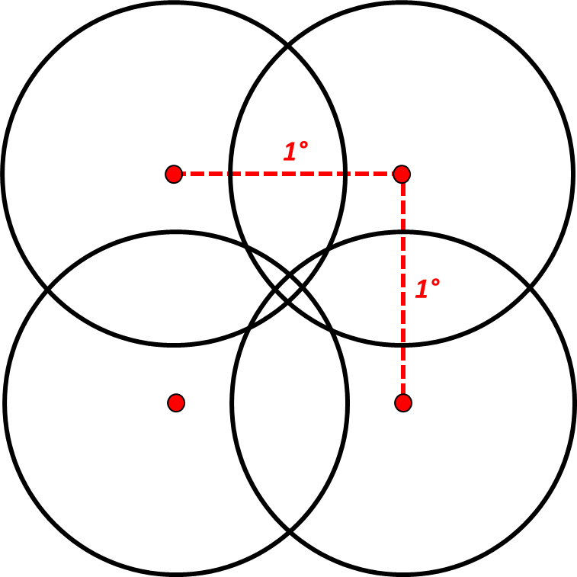
Circular Searching and Hierarchical Granularity

Slide 10
Hierarchical Approach to Sampling the Foursquare Places API
Hierarchy | Spacing Between Samples | Search Radius in Meters
Level 1 | 1.0000° | 80,000
Level 2 | 0.5000° | 40,000
Level 3 | 0.2500° | 20,000
Level 4 | 0.1250° | 10,000
Level 5 | 0.0625° | 5,000

Slide 11
Hierarchical Approach to Sampling the Foursquare Places API
Hierarchy | New Hill Country Venues Retrieved | Cumulative Venues
Level 1 | 302 | 302
Level 2 | 207 | 509
Level 3 | 105 | 614
Level 4 | 13 | 627
Level 5 | 0 | 627

Slide 12
Top Categories for “Hill Country” Venues
Venues | Category
35 | Doctor’s Office
26 | Church
16 | Home Service
14 | Building
13 | Automotive Shop Miscellaneous Shop Office Resort
12 | Construction & Landscaping Dentist’s Office Food Medical Center
11 | Other Great Outdoors Residential Building (Apartment/Condo)
10 | Hotel Real Estate Office

Slide 13
Top Cities for “Hill Country” Venues
Cities | Number of Hill Country Venues
1. San Antonio | 85
2. Austin | 71
3t. Fredericksburg | 41
3t. Kerrville | 41
5. Boerne | 33
6. New Braunfels | 29
7. Canyon Lake | 24
8. Dripping Springs | 23
9. Wimberley | 17
10t. Bee Cave | 15
10t. San Marcos | 15

Slide 14
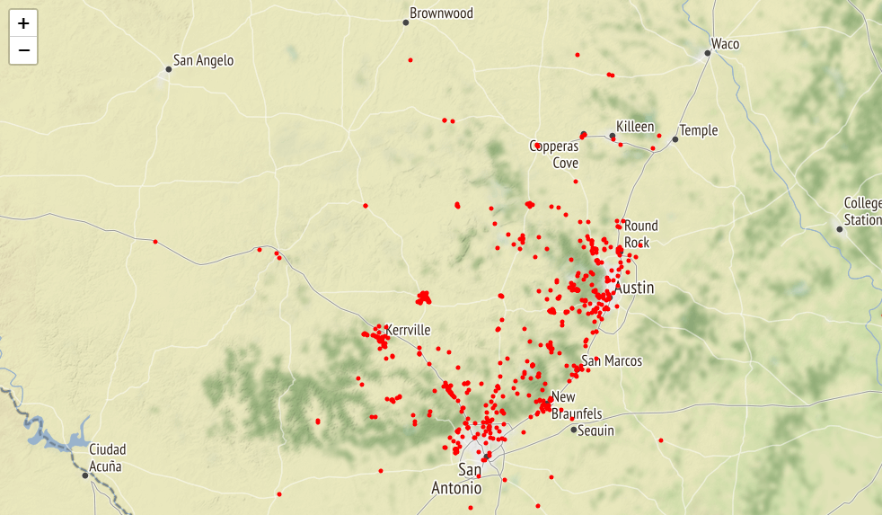
Hill Country Venues Point Map

Slide 15
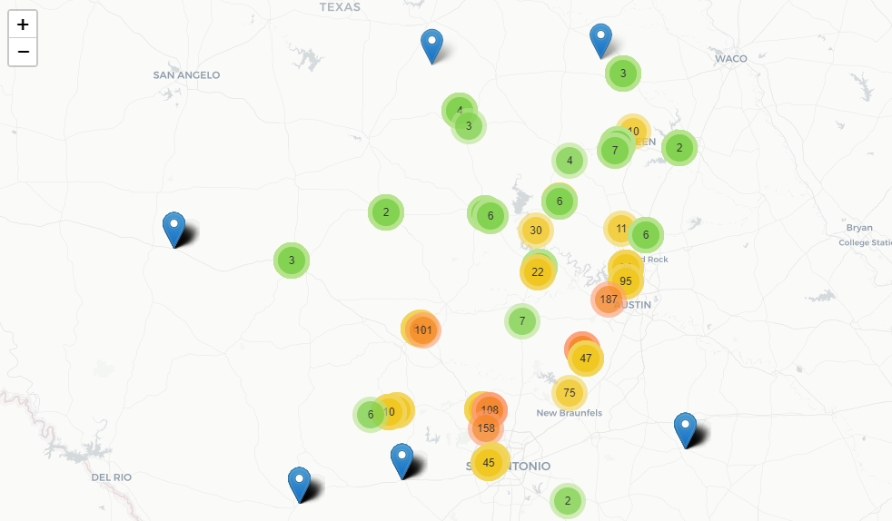
Hill Country Venues Marker Cluster Map

Slide 16
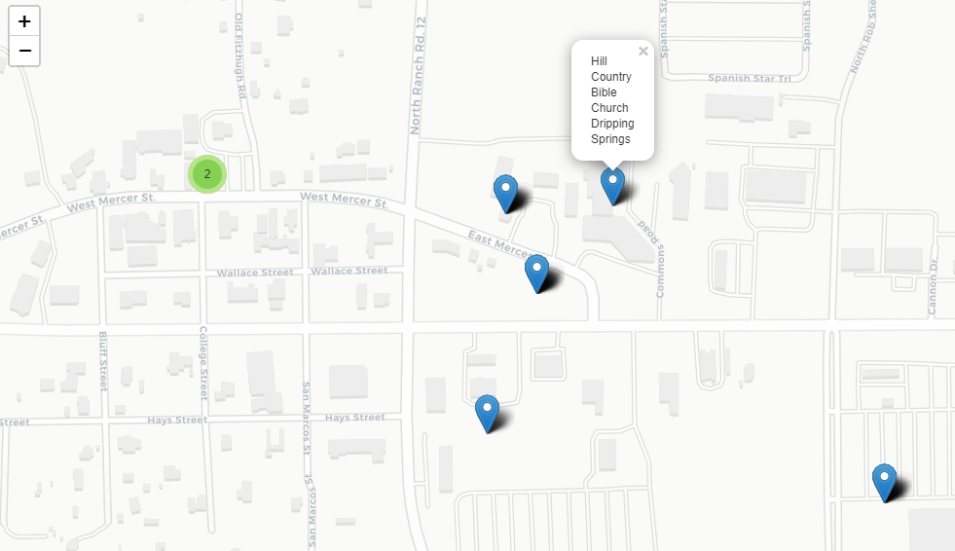
Hill Country Venues Marker Cluster Map

Slide 17
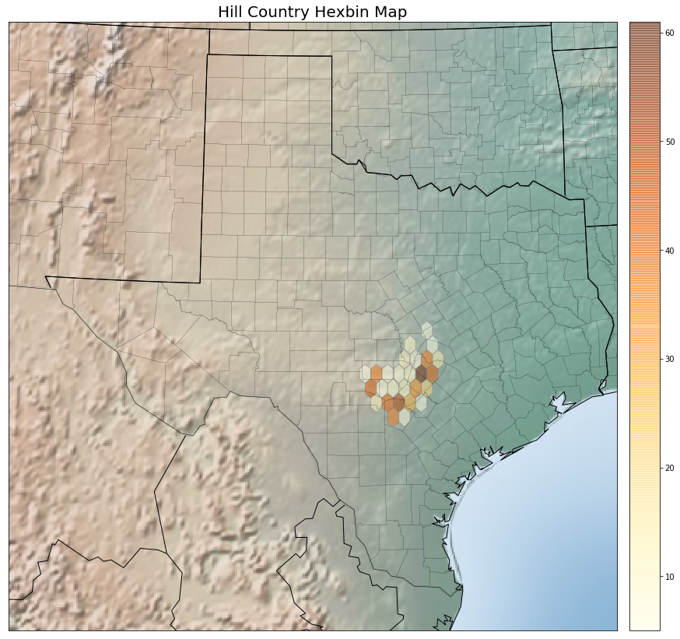
Hill Country Venue Hexbin Map

Slide 18
Top 10 Texas Counties for “Hill Country” Venues per 1,000 Sq Miles
County | Venues | Area in Sq Mi | Venues per 1,000 Sq Mi
1. Comal | 62 | 562 | 110.3
2. Travis | 103 | 989 | 104.1
3. Hays | 65 | 678 | 95.9
4. Bexar | 101 | 1,247 | 90.0
5. Kendall | 41 | 662 | 61.9
6. Kerr | 49 | 1,106 | 44.3
7. Gillespie | 43 | 1,061 | 40.5
8. Williamson | 44 | 1,124 | 39.1
9. Burnet | 27 | 995 | 27.1
10. Bandera | 17 | 792 | 21.5

Slide 19
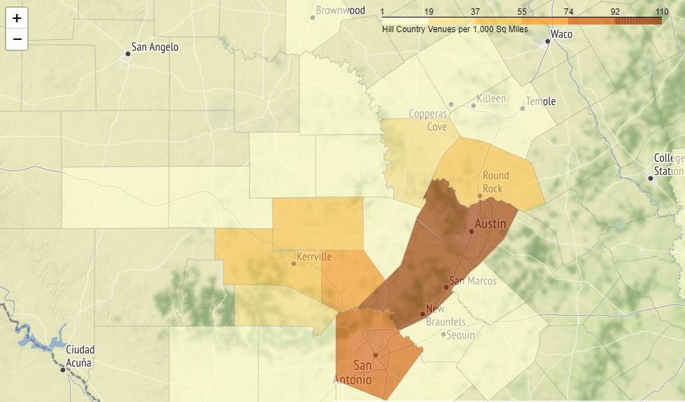
Hill Country Venues per 1,000 Sq Mi

Slide 20
Top 10 Texas Counties for “Hill Country” Venues per Million People
County | Venues | Population | Venues per Million People
1. Gillespie | 43 | 26,646 | 1,613.8
2. McMullen | 1 | 778 | 1,285.3
3. Kerr | 49 | 51,720 | 947.4
4. Kendall | 41 | 44,026 | 931.3
5. Bandera | 17 | 22,351 | 760.6
6. Kimble | 3 | 4,410 | 680.3
7. Blanco | 7 | 11,626 | 602.1
8. Burnet | 27 | 46,804 | 576.8
9. San Saba | 3 | 5,959 | 503.4
10. Mason | 2 | 4,222 | 473.7

Slide 21
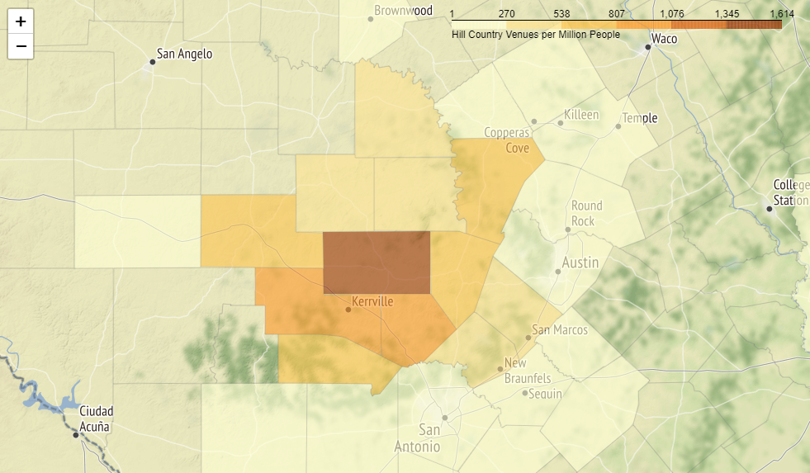
Hill Country Venues per Million People

Slide 22
3 Challenges with Foursquare API
Low Cap on Returned Results
Only 50 venues can be returned on a single API call
Results Based on Relevance
Exact phrases are not honored in the query parameter
“Hill_Country” returns venues with “Hill” and/or “Country” as partial string match
Requires manual filtering later, and irrelevant venues are received that count against the cap of 50 items
Circular Searches
Maximum search radius is 100 kilometers
Non-tessellating shape means searches will have underlap or overlap

Slide 23
Conclusion
“Hill Country” delineated using 627 venues returned from 1,788 API calls
Mapped raw points, clusters, hexbins, and at county level
Normalized for population and area
Heart of region lies immediately west of Austin-San Antonio corridor as well as communities of Kerrville and Fredericksburg
Modern approach to gathering data and delineating a vernacular region
Use of API instead of phone books is faster, more current, and comprehensive
A few lines of code can perform searches, wrangle output, generate a usable dataset, and enable seamless visualization
Able to identify words or phrases as a partial string anywhere in venue name
API results offer additional content such as venue categories, location coordinates, pictures, reviews, etc.

Slide 24
Future Study
Easily adaptable to studying other vernacular regions
“Big Sky”, “Dixie”, “Midwest”, etc.
College Mascots and State Nicknames: Longhorn, Sooner, Buckeye, etc.
Independence Movements: Cascadia, Jefferson, etc.

